Slide 1
Projecting the age distribution of PWH in the US: initial results
Andrew Zalesak & Melissa Schnure

Slide 2
Objectives
Characterize changes in the age distribution of PLWH in the US from 2025-2040
Compare median age and number PLWH over age 55 across states

Slide 3
Methods
Project calibrated state-level models out to 2040 with no intervention
Later, we may introduce an intervention to compare to baseline
Notes:
Will be re-calibrating with a smoother spline function for sexual transmission rates to keep incidence projections reasonable
→ MS: Moved to notes; I don’t think we have to mention that here

Slide 4
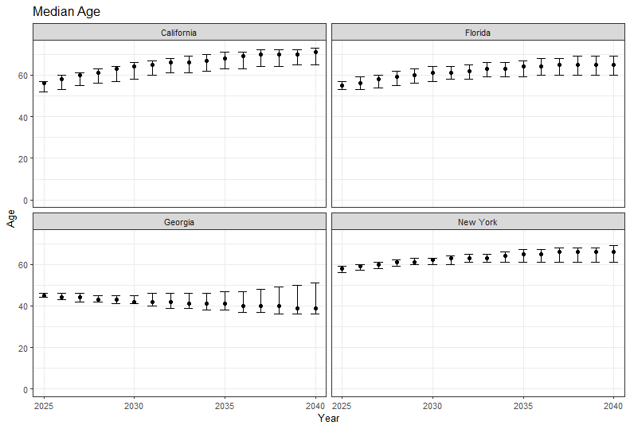


Results: Median Age
2040:
65 (60-69)
2025:
55 (53-57)
2025:
58 (56-59)
2040:
66 (61-69)
2025:
45 (44-46)
2040:
39 (36-51)

Slide 5
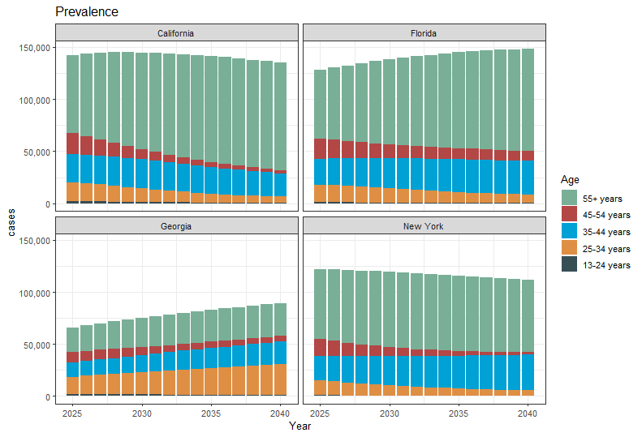
Results: Prevalence Trends by Age

Slide 6
Results: Summary
Measure | Median Age |  |  |  | Number Age 55+ |  |  |  | Proportion Age 55+
Outcome | Diagnosed Prevalence |  | New Diagnoses |  | Diagnosed Prevalence |  | New Diagnoses |  | Diagnosed Prevalence |  | New Diagnoses
Year | 2025 | 2040 | 2025 | 2040 | 2025 | 2040 | 2025 | 2040 | 2025 | 2040 | 2025 | 2040
CA | 56 | 71 | 34 | 37 | 74,500 | 103,725 | 439 | 359 | 0.53% | 0.76% | 0.13% | 0.23%
 | [52-57] | [65-73] | [33-35] | [34-41] | [67,434-78,111] | [91,815-110,442] | [383-511] | [231-448] | [0.47-0.55%] | [0.65-0.83%] | [0.12-0.15%] | [0.14-0.35%]
FL | 55 | 65 | 35 | 38 | 65,732 | 98,583 | 561 | 465 | 0.51% | 0.67% | 0.16% | 0.28%
 | [53-57] | [60-69] | [34-36] | [35-44] | [61,490-69,998] | [87,783-112,236] | [488-619] | [299-584] | [0.48-0.54%] | [0.57-0.75%] | [0.14-0.18%] | [0.16-0.4%]
GA | 45 | 39 | 31 | 32 | 23,218 | 31,567 | 186 | 131 | 0.35% | 0.36% | 0.08% | 0.10%
 | [44-46] | [36-51] | [31-32] | [31-34] | [21,335-24,160] | [27,150-40,188] | [157-221] | [76-192] | [0.33-0.37%] | [0.3-0.49%] | [0.07-0.1%] | [0.05-0.2%]
NY | 58 | 66 | 34 | 36 | 66,908 | 69,530 | 221 | 159 | 0.55% | 0.62% | 0.14% | 0.14%
 | [56-59] | [61-69] | [33-35] | [33-38] | [64,017-68,813] | [61,541-76,228] | [179-274] | [102-313] | [0.53-0.56%] | [0.56-0.69%] | [0.12-0.17%] | [0.1-0.21%]

Slide 7
Questions for You
Should we look at all U.S. states, or deep-dive into a few?
Interventions?
Is the interaction with race/sex worth exploring?
Other ideas for figures?

Slide 8
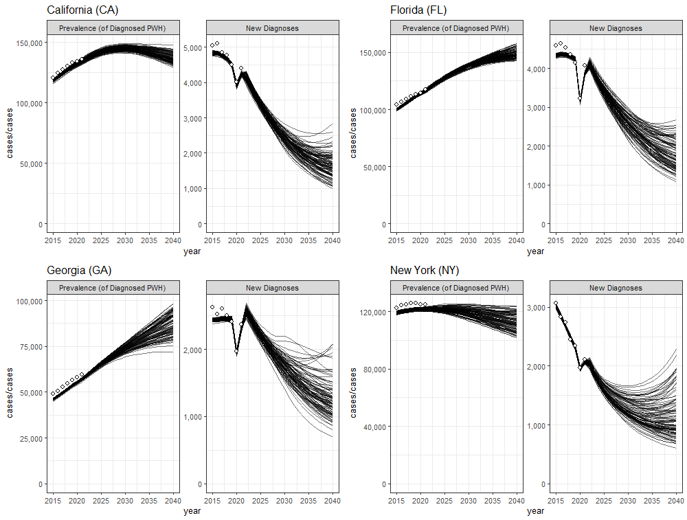

Slide 9
